Slide 1
Computational Applied Mathematics

Slide 2
Introduction
Many mathematical problems in academic research or industry are not solvable without computers .
We explored 3 mini-projects which applied various computational methos to solve problems in applied mathematics.
The three mini-projects we completed can be broken down into three categories: computational, analytical and research.
Notes:
The 3 problems we explored in our projects were using geometric integrators to model planetary orbits, using random numbers to integrate and determining the period of a pendulum.
The computational part required us to write specific code in python to perform steps in a mathematical process. The analytical part required mathematical calculations on paper and the research part focused on our own individual readings to facilitate our exploration of topics.

Slide 3
Monte Carlo Methods in higher dimensions.
Many applications of integrals involve a domain in more than two dimensions.
As the number of dimensions increase the number of points needed to accurately discretise the space becomes significantly large so the quadrature methods become inefficient. This is the curse of dimensionality.
To investigate Monte Carlo methods in higher dimensions we considered the case of an N-dimensional hypersphere inscribed within a cube.
Notes:
Many applications of integrals involve a domain in more than two dimensions, monte carlo methods provide us with a method to approximate the value of such integrals.

Slide 4


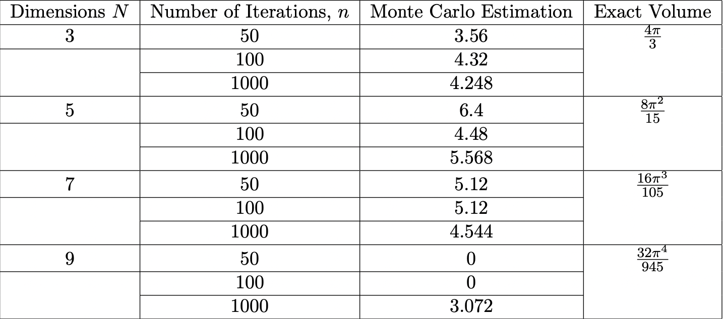
The Volume on an N-Dimension Hypersphere
Monte Carlo estimates for higher dimensions is given by
The exact volume is given by
The table highlights as the number of dimensions increase, many more iterations are required to obtain an estimate
Notes:
It also affects quadrature methods, the number of divisions needed to estimate the integral grows exponentially, requiring nN evaluations of the function. This also becomes problematic when f (x) is discontinuous on the domain V .
The volume of the hypersphere is focused around the boundary layer. As a result, the points randomly generated from the uniform distribution are less likely to ’land’ within the volume of the sphere. This means estimations with a lower number of iterations return zero. This is a problem in the sense that the absolute error is 100% but the relative error is infinitely small because the actual volume is infinitely small.

Slide 5
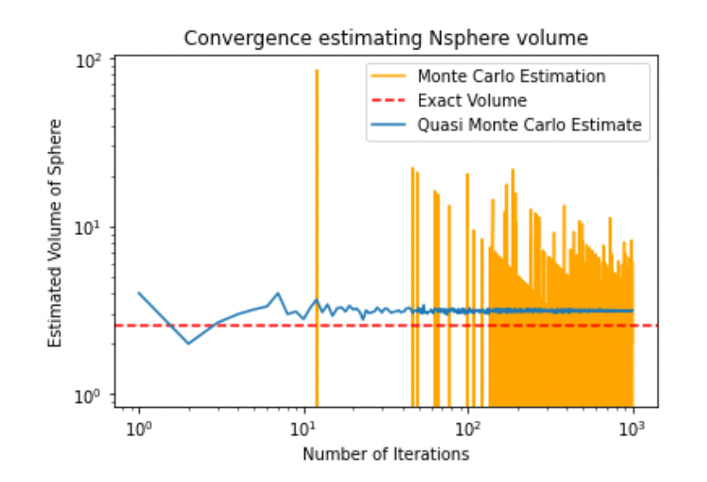
How can we obtain more accurate results?
Different sampling techniques can be employed such as Quasi-Monte Carlo methods.
Quasi Monte Carlo methods use deterministic sequences of variables that are particularly well distributed throughout the space to minimise errors.
We can implement this method in python with a dedicated module for it - (scipy.stats.qmc).
Notes:
Even with only 1000 iterations, figure 2.22 demonstrates the effectiveness of the method com- pared to sampling from a uniform distribution. QMC methods do have N
their own limitations, they can perform badly when singularities exist within a function or when the sequence is chosen badly.

